Slide 1
Big Data Technologies Final Project
Kaleab Berhane

Slide 2
Twitter as Input
10,033 tweets per second
867 million tweets per day
361 Billion tweets estimated for 2022
Notes:
We used Twitter API as an input
“On Average”
That is a lot of data coming in and that is why we chose Twitter - because we believe it would really test the limits of the platforms and tools we have learned.

Slide 3

Ingestion
Hosebird HTTP client -> Kafka
Notes:
To Ingest this data we used
Hosebird - a java based client to read into Twitter’s Streaming API (handles the connections) - developed by Twitter itself.
Then the data is passed into the Kafka Queue which will be pushed to our topic using a producer.

Slide 4
Set up to get the project running
Check if zookeeper is running
service --status-all
Start kafka server
bin/kafka-server-start.sh config/server.properties

Slide 5
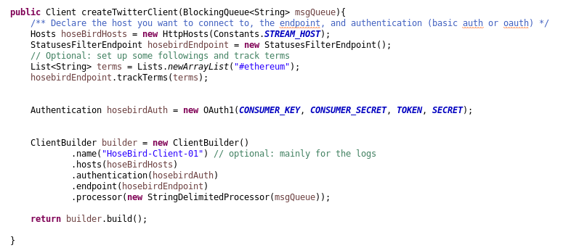
Notes:
A Section of our ingestion class.
As you can see
HoseBird handles the authentication and getting the data
We then place that into the Kafka Queue #82
You can also see some of the kafka producer’s key value serialization properties - in our case they are both strings.

Slide 6
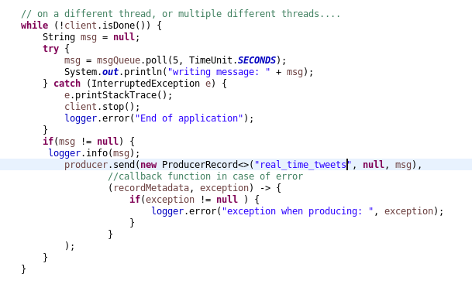

Slide 7

Consumption
Kafka Consumer - to accept the data
Spark Streaming - Selective operations
Notes:
Then we have the second half of our streaming process.

Slide 8
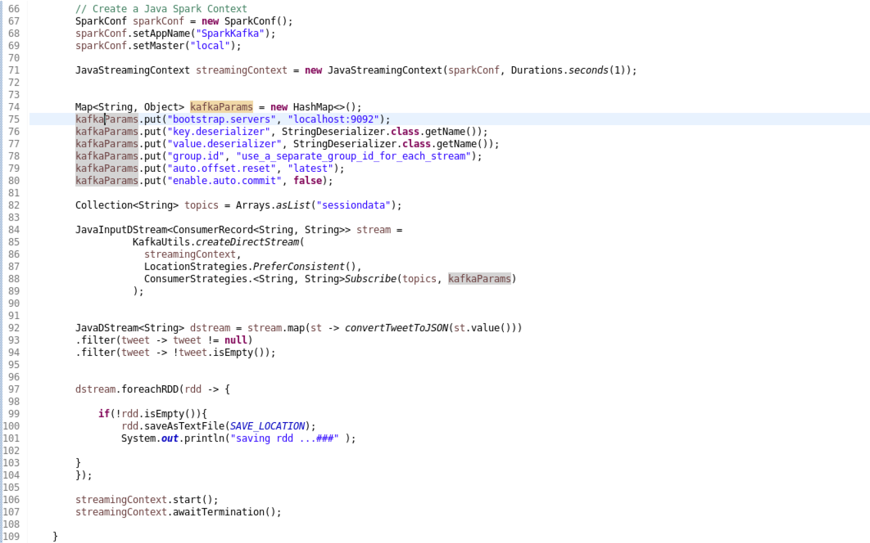
Notes:
We have our consumer class
We see parameters that has the deserialization and host address
Create a consumer and subscribe to our topic #84
Spark #94 - functional programming to clean up input
- convertTweetToJSON

Slide 9
Demo Time
Notes:
Pass you to my colleague Daniel, for the Demonstration

